Slide 1
Chi-Square Test for
Independence
Prepared by
Sajana Shakya

Slide 2
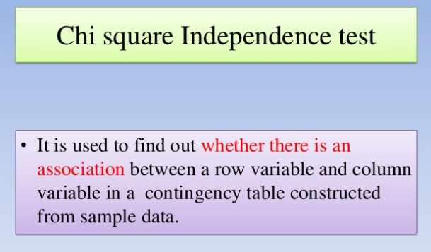

Slide 3
When to Use Chi-Square Test for Independence
There should be two variables.
The variables under study are each categorical.
The sample size should be large. n ≥ 50.
the expected frequency count for each cell of the table is at least 5.
The sampling method is simple random sampling.

Slide 4

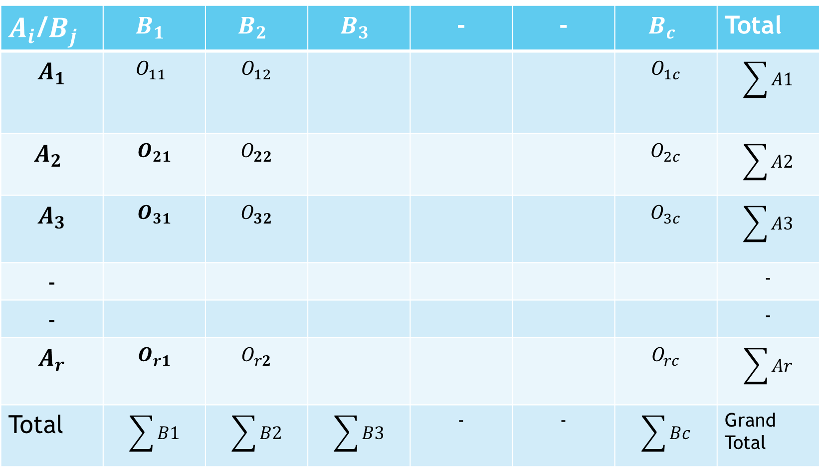
Contingency table
$O_{ij}$=Observed frequency
(B)
$A_{i}$/$B_{j}$ | $$B_{1}$$ | $$B_{2}$$ | $$B_{3}$$ | - | - | $$B_{c}$$ | Total
$$A_{1}$$ | $$O_{11}$$ | $$O_{12}$$ |  |  |  | $$O_{1c}$$ | $$\sum{A1}$$
$$A_{2}$$ | $$O_{21}$$ | $$O_{22}$$ |  |  |  | $$O_{2c}$$ | $$\sum{A2}$$
$$A_{3}$$ | $$O_{31}$$ | $$O_{32}$$ |  |  |  | $$O_{3c}$$ | $$\sum{A3}$$
- |  |  |  |  |  |  | -
- |  |  |  |  |  |  | -
$$A_{r}$$ | $$O_{r1}$$ | $$O_{r2}$$ |  |  |  | $$O_{rc}$$ | $$\sum{Ar}$$
Total | $$\sum{B1}$$ | $$\sum{B2}$$ | $$\sum{B3}$$ | - | - | $$\sum{Bc}$$ | Grand Total
(A)

Slide 5
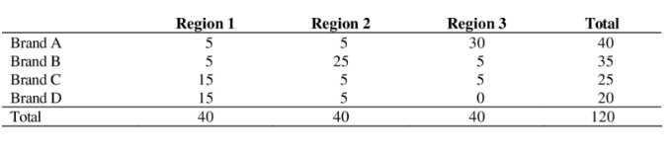
Brand by region contingency table

Slide 6
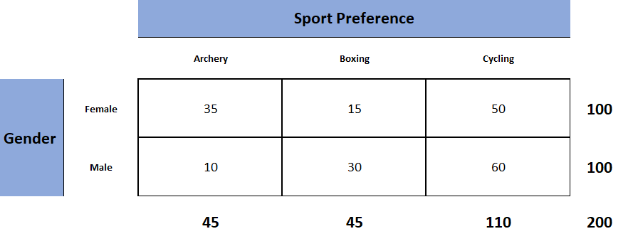
The above table is known as the observed table as it contains the observed counts.

Slide 7
Step 1:
Null hypothesis: There is no association between gender and sport preference. The two variables are independent.
Alternative hypothesis: There is association between gender and sport preference. The two variables are not independent.
Step 2: Select Significance level α=5%

Slide 8
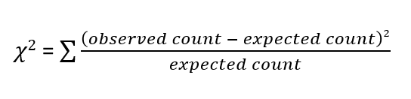
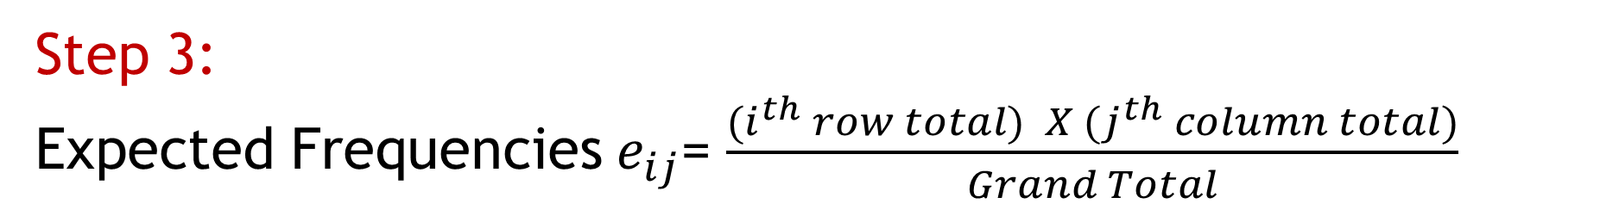
Step 3:
Expected Frequencies${ e}_{ij}$= $\frac{{(i}^{th} row total) X {(j}^{th} column total)}{Grand Total}$

Slide 9
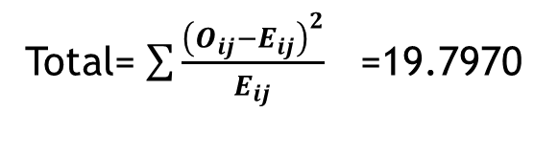
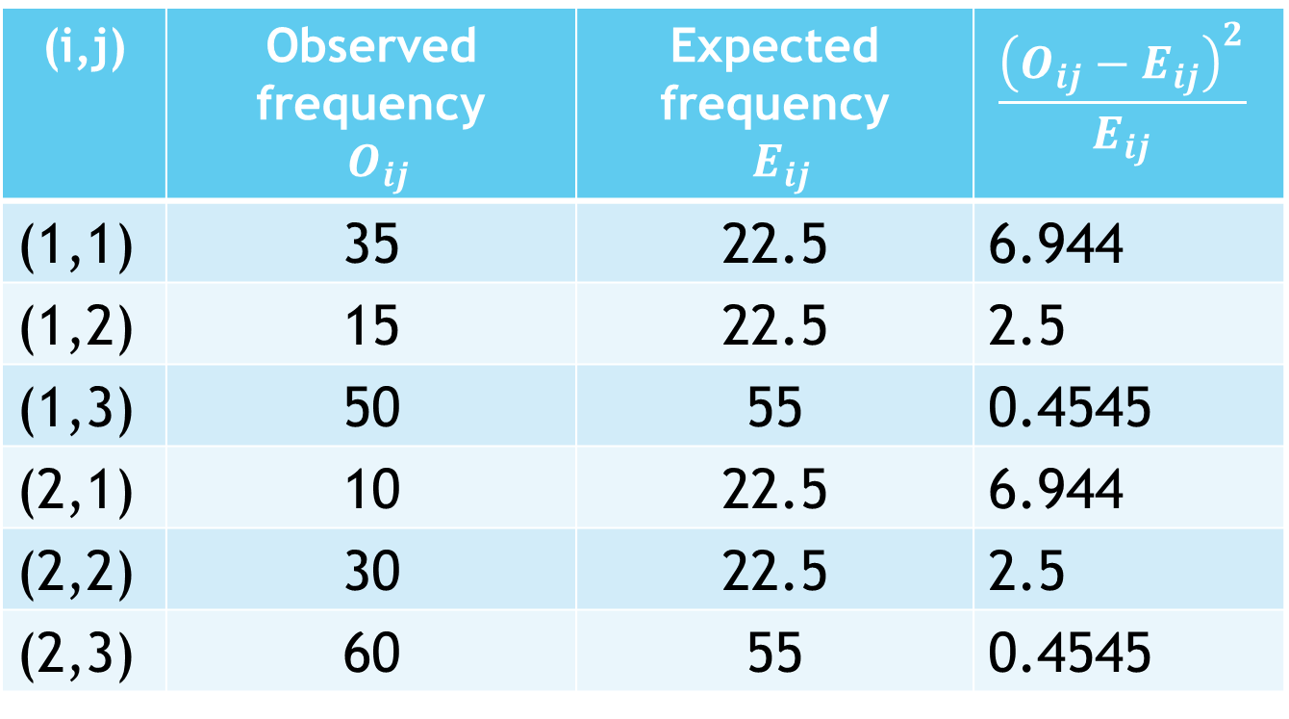
Calculation table for expected frequencies and chi-square value
(i,j) | Observed frequency $O_{ij}$ | Expected frequency $E_{ij}$ | $$\frac{{\left(O_{ij}−E_{ij}\right)}^{2}}{E_{ij}}$$
(1,1) | 35 | 22.5 | 6.944
(1,2) | 15 | 22.5 | 2.5
(1,3) | 50 | 55 | 0.4545
(2,1) | 10 | 22.5 | 6.944
(2,2) | 30 | 22.5 | 2.5
(2,3) | 60 | 55 | 0.4545
Total= $\sum{\frac{{\left(O_{ij}−E_{ij}\right)}^{2}}{E_{ij}}}$ =19.7970

Slide 10
Step 4: For a table with r rows and c columns, degrees of freedom can be calculated by the following formula.
Degrees of freedom =(r-1) (c-1)
=(2-1) (3-1) therefore, for our example, we have 2 degrees of freedom.
If we know the significance level (usually 0.05) and the degrees of freedom we can get the critical value from the chi-square table. The significance level is the probability of rejecting a true null hypothesis.

Slide 11
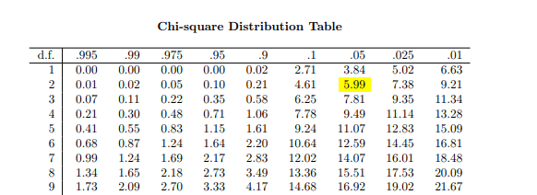
From the below table we can see that the critical value
of the test statistic is 5.99 for a significance level of 0.05
and 2 degrees of freedom.

Slide 12
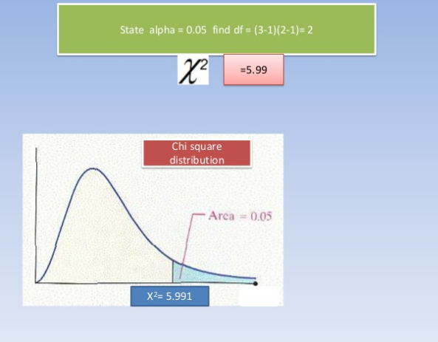
(1-α)
Acceptance region
α Critical region

Slide 13
Step 5:
Decision: Since the observed value of the test statistic is greater than its critical value (19.798 > 5.99), we can reject the null hypothesis and conclude that choice of sport is not independent of gender.

Slide 14
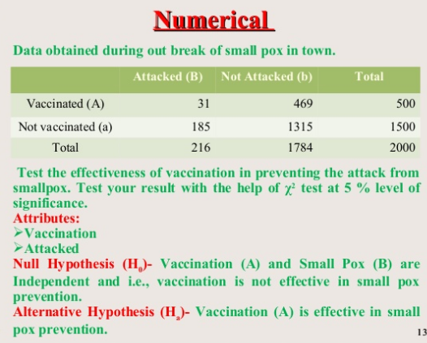

Slide 15
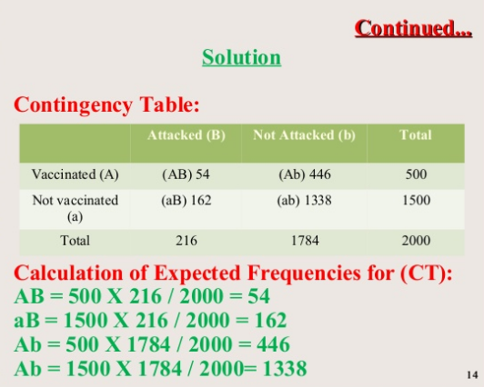

Slide 16
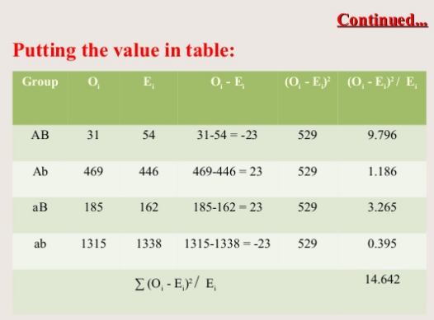

Slide 17
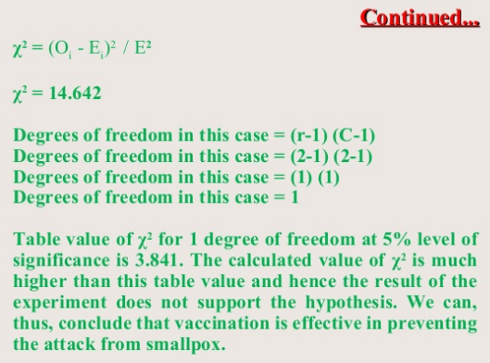

Slide 18
